Slide 1

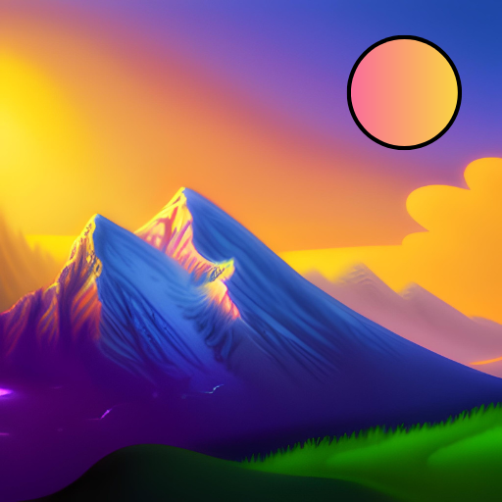
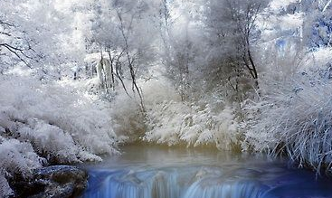
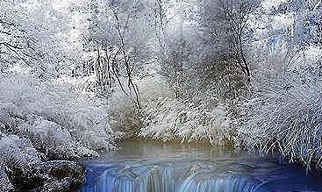
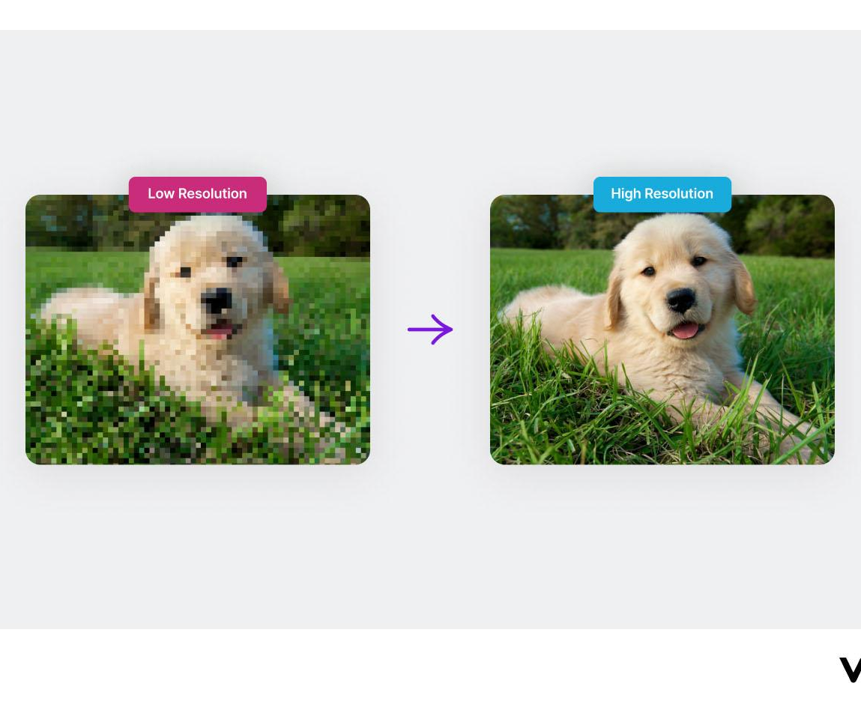
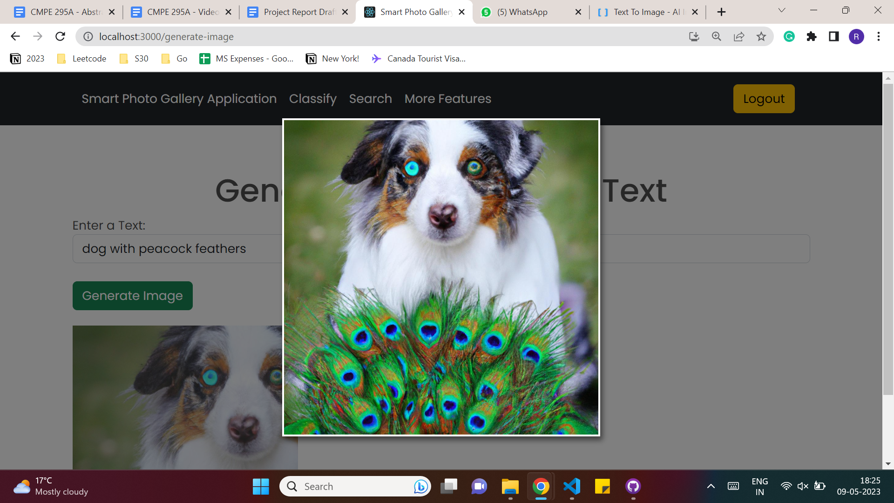
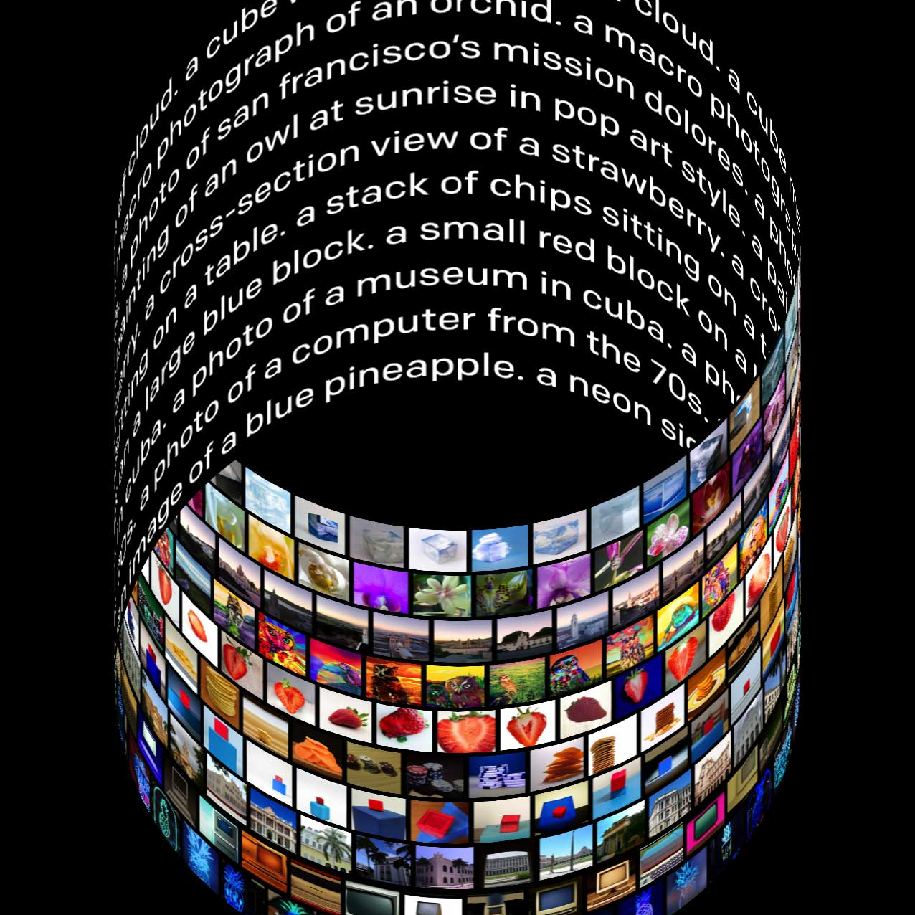
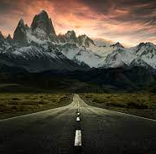

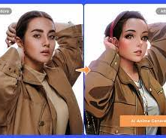
Computer Engineering Department
Smart Photo Gallery Application
Project Advisor: Vijay Eranti
Shah, Rajvi (MS Software Engineering)
Modi, Khushil Ketankumar
(MS Software Engineering)
Patel, Sarjak Rajeshbhai
(MS Software Engineering)
Yeruva, Vishnu Vardhan Reddy
(MS Software Engineering)
Introduction
Methodology
In this case, the diffusion process is applied to the image, causing the colors and edges to spread gradually and create a cartoon-like effect. This technique is achieved through the use of mathematical models, such as partial differential equations, that simulate the diffusion process.
Analysis
People classification and image search is working accurately with all human faces (with or without props).
Text extraction is able to detect characters, numbers, and special characters.
Remove background feature is able to differentiate the person and background efficiently.
Image generator creates highly detailed and complex images from textual descriptions, allowing users to generate images of objects, scenes, and concepts that may not even exist in the real world.
Applications are generally designed traditionally as two types, one is giving what is required and the other one is giving what is expected. Out of these two there is something that is practical, smart and useful. Integrating a whole new application into the world of multimedia that actually organizes and provides an interface for a lot of AI powered tools like editor and search engine is completely a challenging task.
In this project, we tried to implement different trials on different algorithms and multiple classifiers to build models and API’s and researched on multiple base models to integrate features from different classifiers and to have hybrid models for certain features to meet the requirements.
Super Image Resolution
It is a task where the the goal is to increase the resolution of an image, usually by a factor of 4x or more, while maintaining its content and details as much as possible.
Even if the input image is blurry, the resultant image will be so clear and minute details of the image that were not visible would be visible in the output generated. It can be used for surveillance from security cameras, medical imaging and digital entertainment industries.
Using Opencv we can unblur the image. The objective is to restore the original image. In the core it functions the degradation image model where it achieves the original spectrum by removing additive noise, frequency of the spectrum and frequency response.
Analysis and Results
The results achieved from various different models are displayed below. The first is the super image resolution applied on blur images to enhance their resolution over multiple times. The below image shows the blur image (on left) and its output (on right) the resultant unblur image. It helps in medical imaging, identify faces from security footage and much more.
Summary/Conclusions
The primary objective of this application is to be a simple yet most useful/ functional application for photo albums with powerful algorithms to process the image as per the liking and to detect those features which are useful to make life a little easier.
The overall outcome of this application combines current state of art algorithms with most efficient and unique approaches. But in fairness, even though one of the top most applications such as google photos has features that are not so limited but less in comparison has a very great way of integration and implementation.
The output from text to image generation is showed below in the image. The Dall-E model generated it for the input given as “Dog with peacock feathers”. We can generate any existent or non existent images just from elaborating it in the textual terms and it can provide great breakthrough in the field of e-commerce, design, story-telling, etc.
Implemented scene recognition, object detection, OCR, and people classification with OpenCV. Utilize these techniques to organize albums, search images by text, suggest and create albums. Apply VGG19 for image editing based on emotion and sentiment analysis for auto-enhancement using default presets.
[1] Orr, William Keth. (2015). An application of linear programming to Optical Character Recognition, OCLC Number 13790387.
[2] Pathak, A. R., Pandey, M., & Rautaray, S. (2018). Application of Deep Learning for Object Detection. Procedia Computer Science, 132, 1706-1717.
[3] Wang, S., & Su, Z. (2019). Metamorphic Testing for Object Detection Systems.
[4] Y Sun, X Wang and X. Tang, "Deep learning face representation from predicting 10000 classes[C]", Proceedings of IEEE Conference on Computer Vision and Pattern Recognition, pp. 1891-1898, 2014.
[5] X. Han and Q. Du, "Research on face recognition based on deep learning," 2018 Sixth International Conference on Digital Information, Networking, and Wireless Communications (DINWC), 2018, pp. 53-58, doi: 10.1109/DINWC.2018.8356995.
The proposed algorithm learn from large datasets of high-resolution images and use this knowledge to predict the missing details and enhance the image quality. The enhanced visual effects provide a more realistic and immersive experience that makes precision more accurate and engaging.
Image Cartoonification using Diffusion Models
Converting the images into cartoon using transformers, state of the art model VGG 19, one of the most powerful deep learning algorithms that uses 19 layers of prediction levels. It has an extraction feature from statistical convolution neural networks. Where this state of the art method is used to produce high quality images.
Using this feature allows us to convert human image to cartoon image. This feature helps to give realistic feel to industries such as gaming, anime, movies, etc. It is helpful to create our more realistic avatars in the virtual worlds where people are socializing most of their time currently.
Key References
Methodology
Text to Image Generation
Text to Image Generation is a task in computer vision and natural language processing where the goal is to generate an image that corresponds to a given textual description.
The following image shows the input image (on left) of a landscape and it’s cartoonified using diffusion models and the output image (on right) generated is cartoonish. These kind of outputs generated from real images are used in making digital entertainment such as video games, animated movies, series, etc.
Acknowledgements
The authors are deeply indebted to Professor Dan Harkey and Professor Vijay Eranti for their invaluable comments and guidance in the course of this project.
Conversion of process from text typed to the image by using Dall-E. Dall-E is the most advanced neural network. It is a 12-billion parameter version of text language processing GPT-3 which was trained to generate images from text descriptions. In the core it has a diverse set of libraries that we can create even anthropomorphized versions of animals and objects as well.

